Slide 1
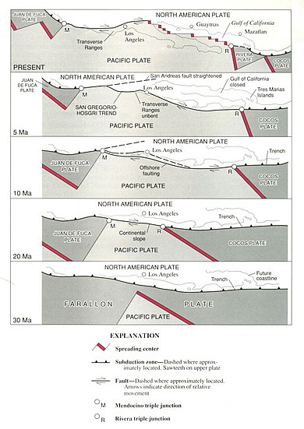
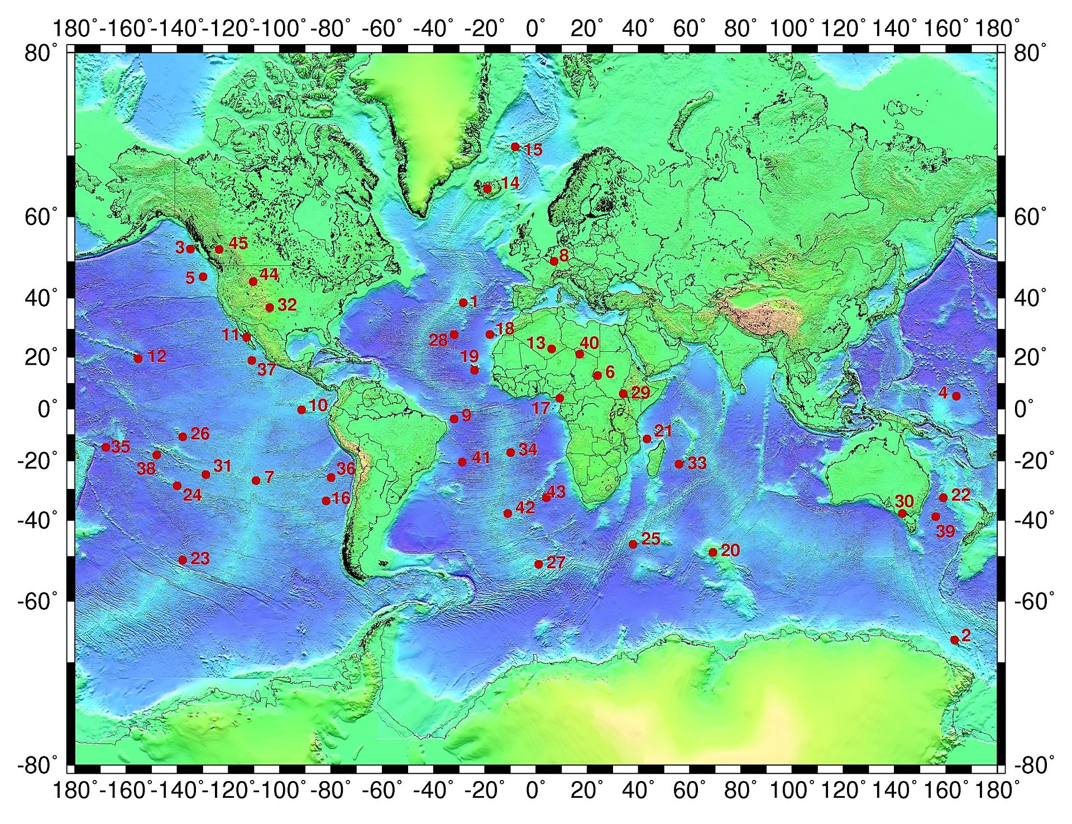
Correlation of Plate Motions with Continental Tectonics: Laramide to Basin-Range
Engebreston et al., 1984
GEOL 730
Yair Franco

Slide 2
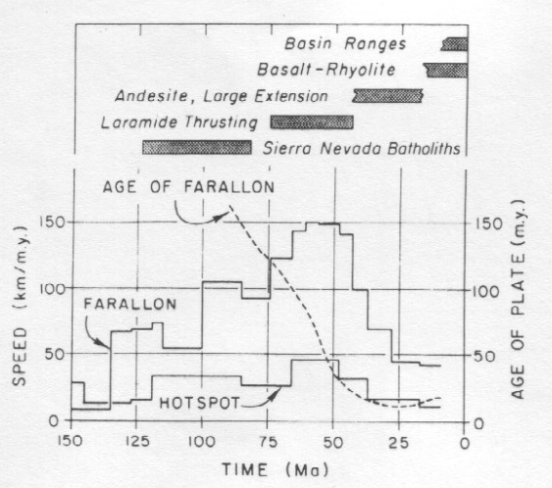
Model for North American Plate motion
Motive: to correlate Pacific Plate motions to events well inside the North American Plate
Data sets:
Ages of inland events
Relative plate motion rates based on hotspots
Age of subducting Farallon Plate

Slide 3
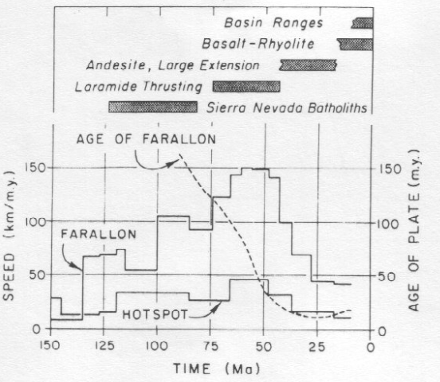
Major Events
80 Ma: end of Sierra batholith formation, start of Laramide thrusting
Coincides with a sharp decrease in age of Farallon Plate
40 Ma: onset of extension, ignimbrite and metamorphic core complexes
Coincides with slowdown of plate convergence
15-20 Ma: Volcanism moves westward

Slide 4
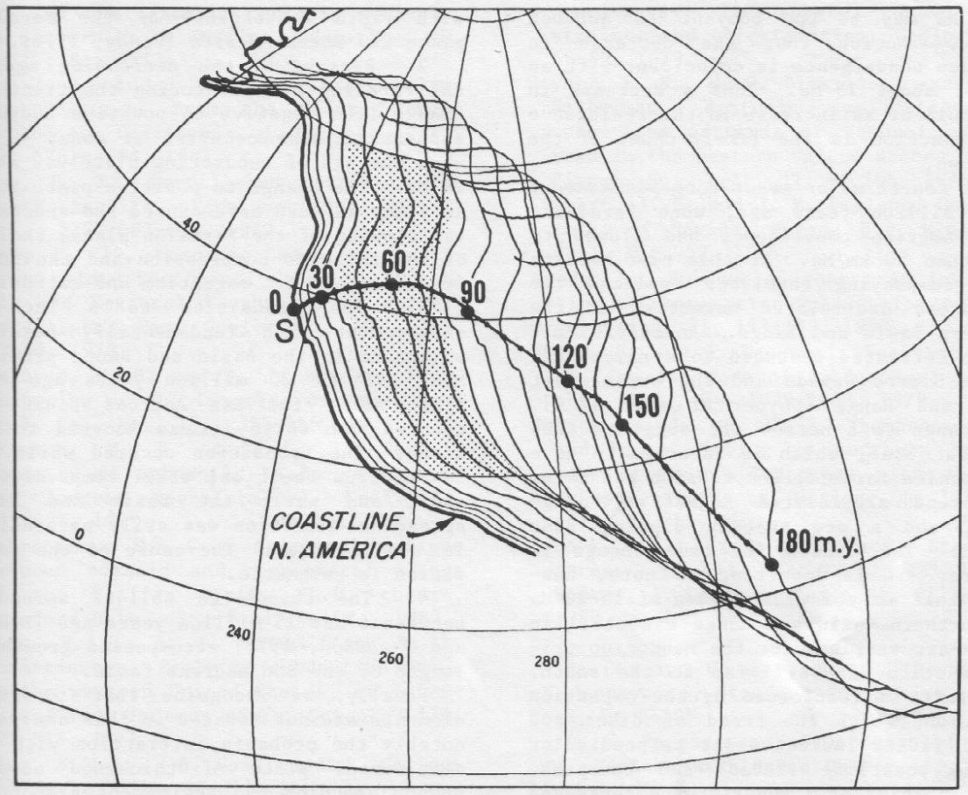
Motion model based on Atlantic hotspot tracks
Notes:
Dot: San Francisco
Shade: Laramide time span

Slide 5
Discussion and Summary
Laramide formation:
Fast plate motion suggests Farallon Plate was well anchored and sinking
Becomes buoyant as subducting plate gets younger, slowing the plate
Back-arc volcanism:
Direction of spreading still perpendicular
“Enigmatic”

